Slide 1
Speaker recognition using keywords and key hypernyms
20130690 Sumin Han

Slide 2
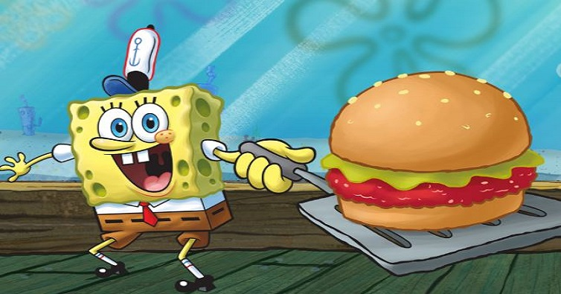
Question
Can we recognize the speaker in a spoken corpus
using keywords and key hypernyms?
???: I love my job at the Krusty Krab, I like Jelly-Fishing and Bubble-Blowing. I've never been late for work!

Slide 3
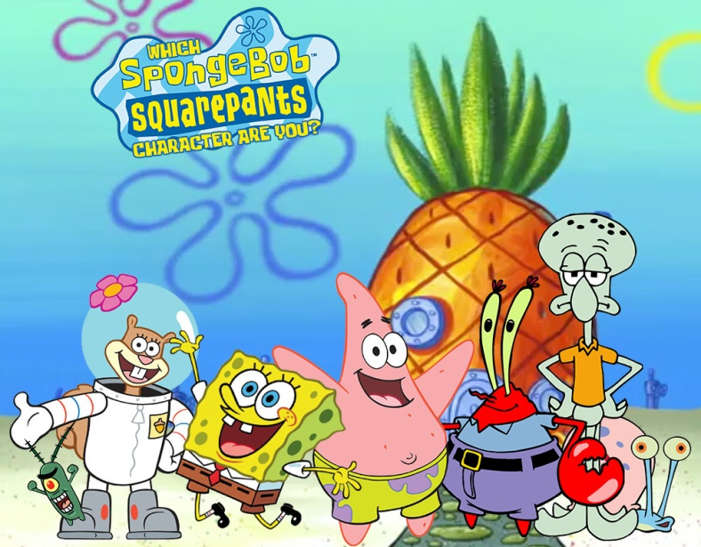
Motivation
Mostly any character has strong personality.
Each character may speak some particular words frequently which makes them distinguishable.
➔ Research their keywords

Slide 4
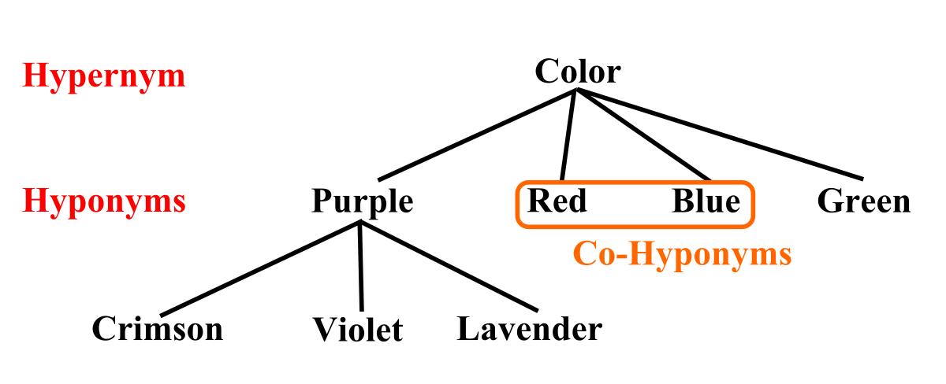
Plus, Hypernym
In linguistics, a hyponym is a word or phrase whose semantic field is included within that of another word, its hypernym.

Slide 5
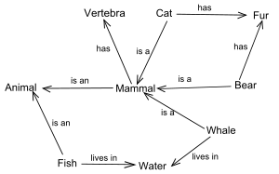
Hypernym Network
We can see “Mammal” has many in/out edges ➔ “Key Hypernym”

Slide 6
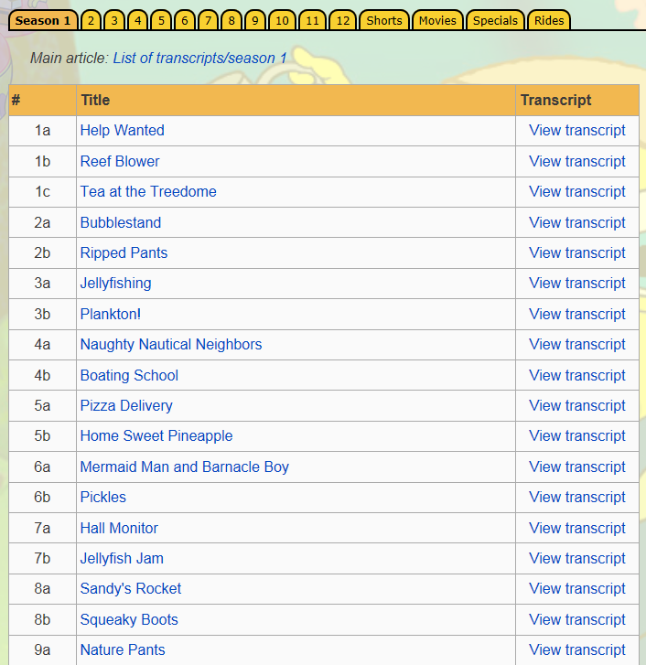
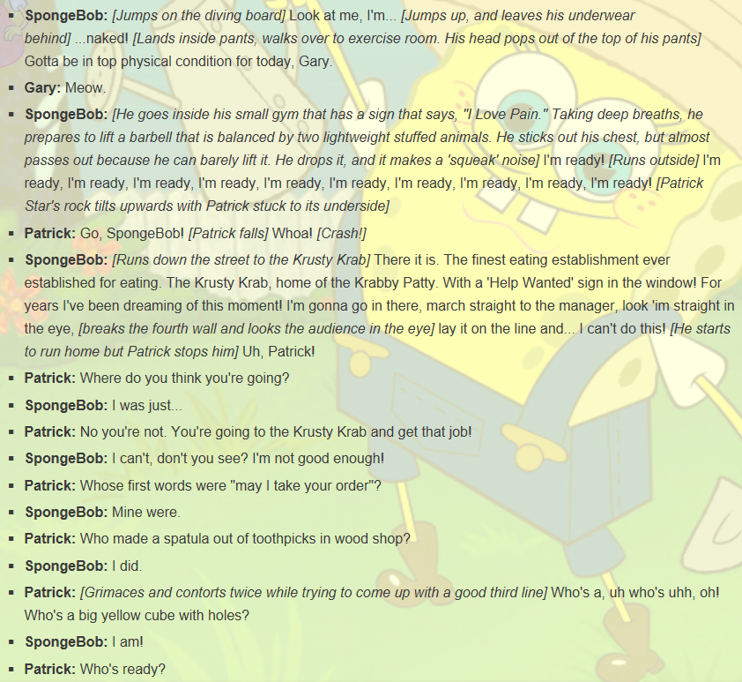
Corpus
http://spongebob.wikia.com/wiki/List_of_transcripts
Transcripts of “SpongeBob”
Total 538 files (2.94MB).

Slide 7
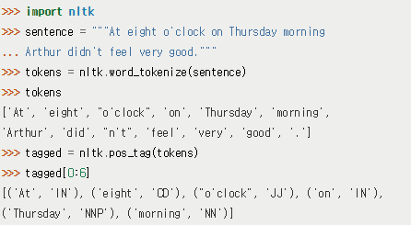
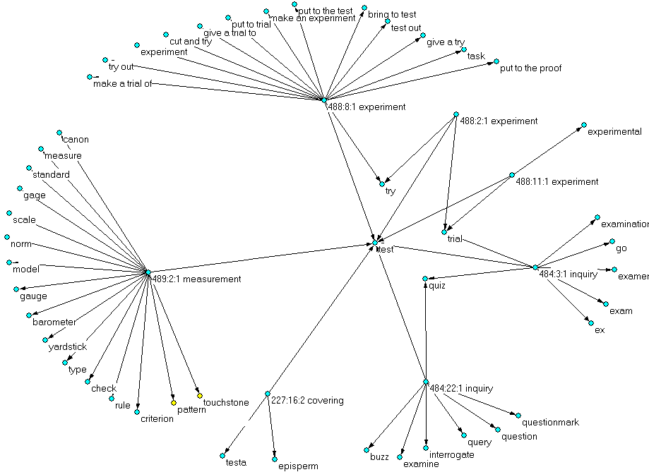
Methods
>>> dog = wn.synset('dog.n.01')
>>> dog.hypernyms() [Synset('canine.n.02'), Synset('domestic_animal.n.01')]
Antconc and TagAnt for the keyword analyzation and tagging the words.
Python and the NLTK[1](Natural Language Toolkit) package as the primary tool for programming, making hypernym network.
Gephi, Pajek[2] to draw network and analyze.

Slide 8
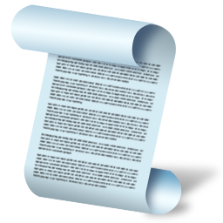
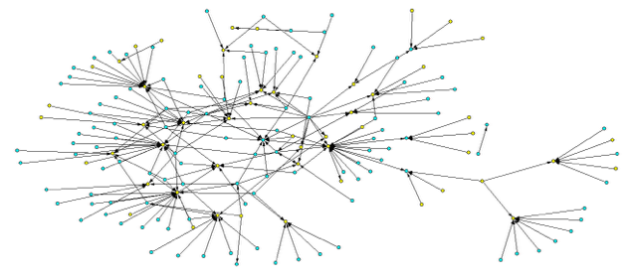
Methods (cont.)
Mr.Krabs
Patrick
SpongeBob
Distance calculation
Standard
Hypernyms
match
Extract Standard Key Hypernyms
SpongeBob
Random Script
Patrick
Mr.Krabs

Slide 9
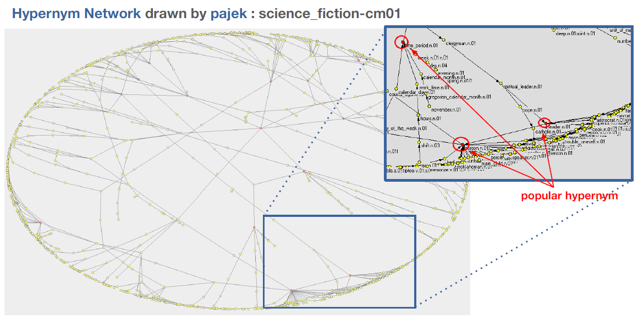
Methods (cont.)
Key Hypernyms

Slide 10
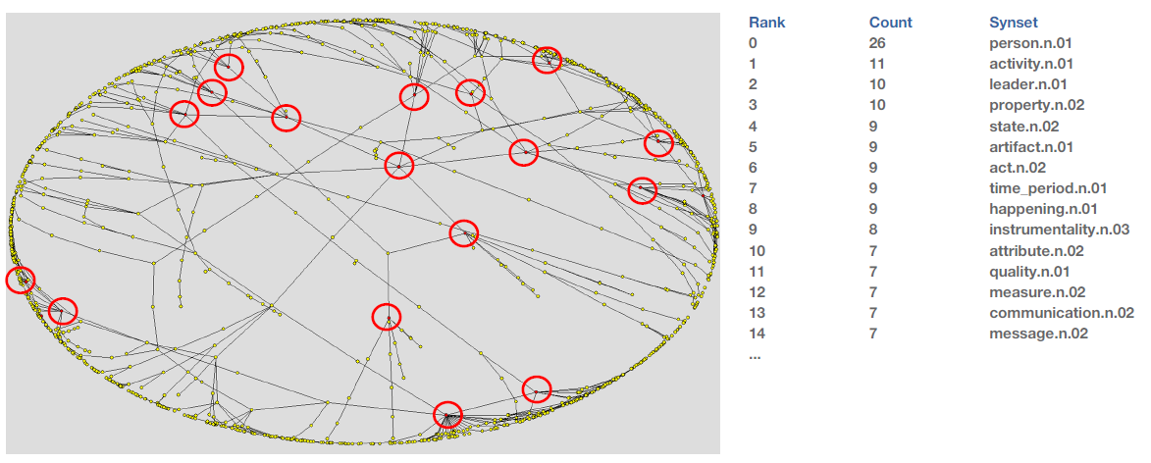
Methods (cont.)

Slide 11
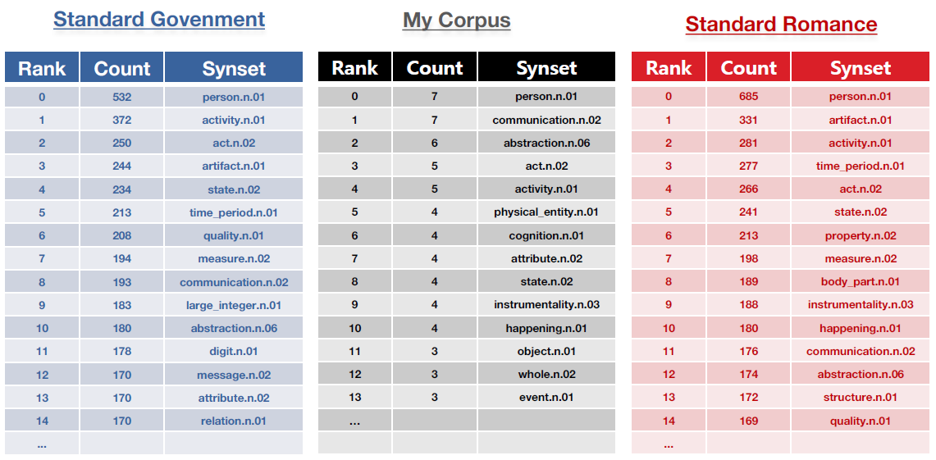
Methods (cont.)
SpongeBob
Patrick
Compare (How?)

Slide 12
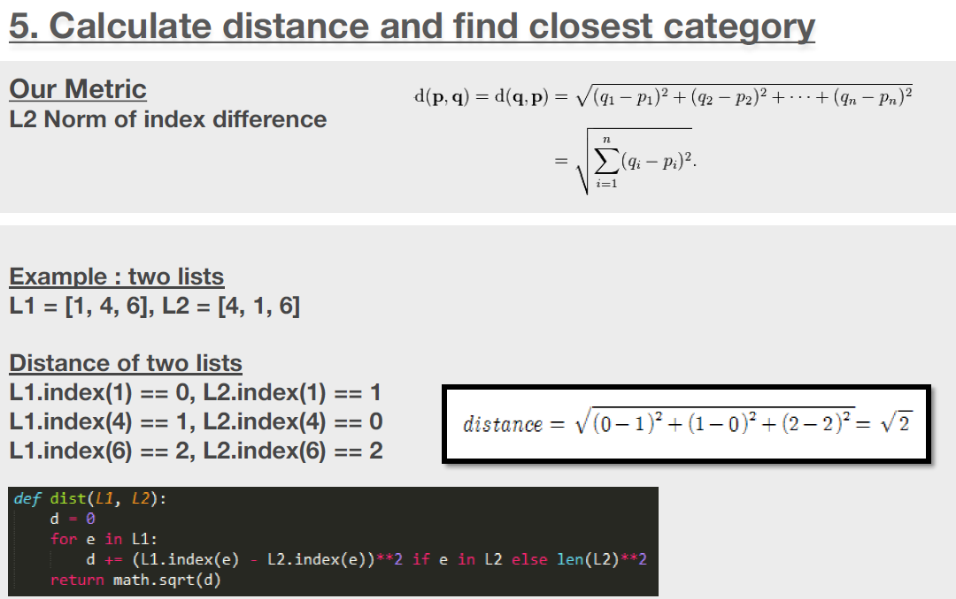
Methods (cont.)

Slide 13
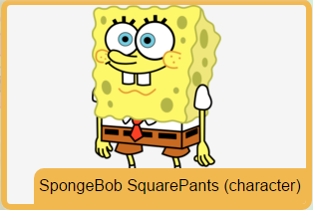
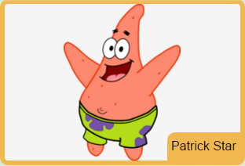
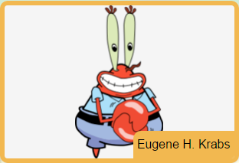
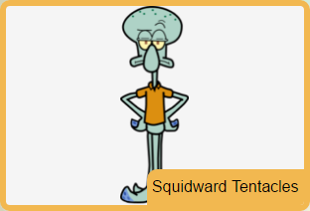
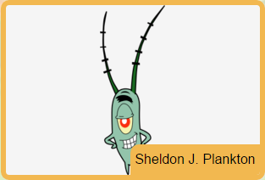
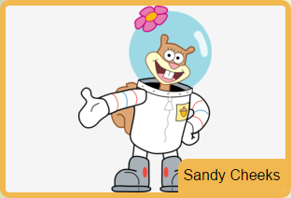
Expected Result/Conclusion
Krabby Patty, spatula, jellyfish, driving license
buddy, friends, play outside
money, business
clarinet, art
secret, formula, machine, fail
Karate, science

Slide 14
Speaker Recognition
Keyword
Key Hypernym
Plankton: Why couldn't I see it before? The way to get the Krabby Patty formula was so obvious!
SpongeBob: Yoo-hoo! Who wants their tummies tickled?
Plankton: No... My weapons! Ouch!
SpongeBob: Sea bears aren't weapons, Plankton. They're furry buckets of love. See? And what do sea bears love more than tummy tickles? Jellyfish honey!
Mr. Krabs: Why do you keep doing this, Plankton?
Plankton: Heh-heh-heh...
Mr. Krabs: When you mess with me business, ya mess with me money!
Plankton: Er, money's not everything, you know.
Mr. Krabs: 'Course it is! Money makes the world go round, and makes me heart go pound.

Slide 15
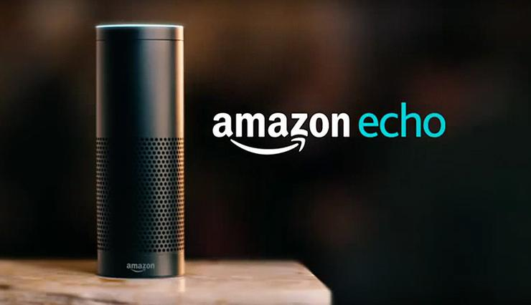
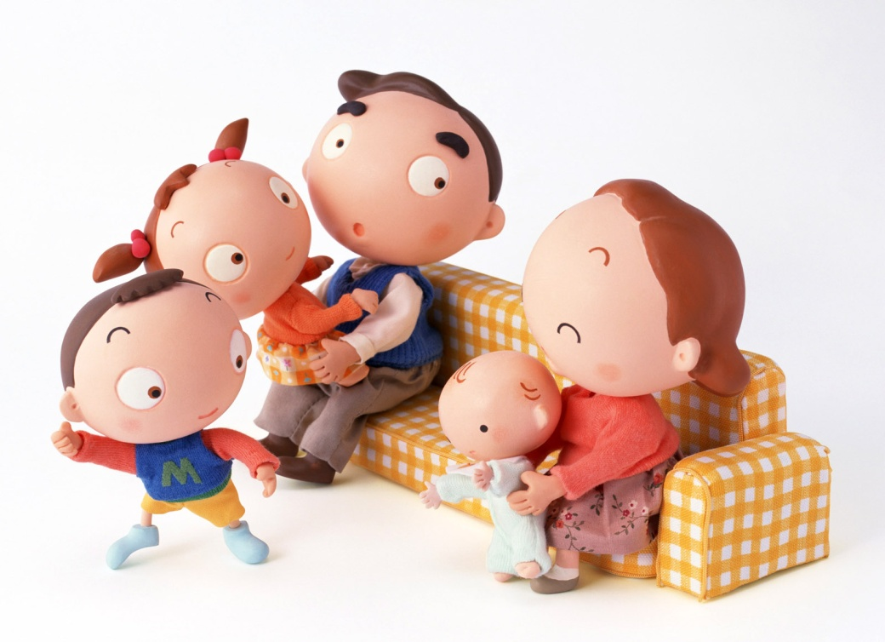
Implication
Mike, your favorite Oreo is on the table.
#$@^...
#$@%...
Mom, I’m hungry!

